Slide 1
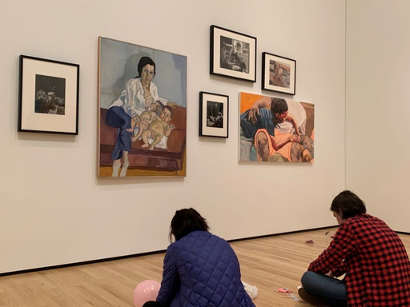


Professional Identity Transformation: An art museum-based elective
Explore what it means to be human, to be a physician, and to lead a good life, for yourself and your patients
Sept 14th - Oct 13th, 2023
Directed by Dr. Meg Chisolm, this full-time course includes 17 in-person sessions co-led by medical and museum educators at:
the Baltimore Museum
of Art, American Visionary
Art Museum, Walters Art Museum, Evergreen Museum and Library, Homewood Museum, and other community locations
Who can participate?
Enrollment is limited to 15 students!
Any clinical year medical student is invited to enroll, although the course is designed specifically to prepare 4th year students to thrive personally and professionally during residency training and beyond
Please submit your elective registration through the registrar's online portal soon to be assured a spot in this course.
What past students have said:
Questions? Contact Jessica Lewis, course coordinator, @jlewi155@jhu.edu
“This course has been a real highlight of
my medical education thus far and I expect the lessons learned will help me become a more empathic and effective physician and overall person."
“So many activities asked us to evaluate who we were, how we felt and what we wanted that it became a space to critically think about our values and whether we were living by them.”
"I feel more hope for my future as a physician, and more confidence in my abilities to face the future."

